Slide 1
Discover Land Cover and Flooding in Georgia!
Summer Sun

Slide 2
WHO AM I?
Summer (Jinghan) Sun
Senior (Last Semester and only 1 class! Yay!)
Quantitative Sciences track East Asian Studies + CS minor
Why this project?
Interest in Environmental Science
Gain hands on data science experience
Tried to do something for the community

Slide 3
About My Project
Flooding is getting more frequent
They are five times more common than they were in the 1950s
Flood can cause loss of life and economic losses
People need to know:
Factors that are leading to more floodings
Whether they are in flood hazard area, so they can take actions beforehand, e.g., buy insurance
Explore change in land cover, especially deforestation, and its relation to flooding
Make clearer visualizations about flooding hazard areas
The data of overall flooding trend mentioned are available at https://www.epa.gov/climate-indicators/climate-change-indicators-coastal-flooding
Notes:
Georgia is damp place: flood not only have destructive issue and lingering issues such as mold issue and cause pollutant & health issue
Provide individual cases – example of things ppl can do case study into (things made flood worse), other factors
Community is in the ongoing struggle with removing trees for a bunch of reason. Info in this project is valuable for them to fight
Increasing biomass industry: data center: consume power and require power that state using biomass (energy drive towards deforestation) – respiratory issue

Slide 4
Methodology (What we are gonna do)
Gather and filter our all the necessary data (hardest)
Using Python (Geopanda) or R and ESRI to identify trends
Factors to explore: Change in types of land cover (e.g. forest, developed sites), flood frequency, flood hazard zones
Make Visualizations and presentations to demonstrate the effect to the public
More aspects as long as you find its interesting!

Slide 5
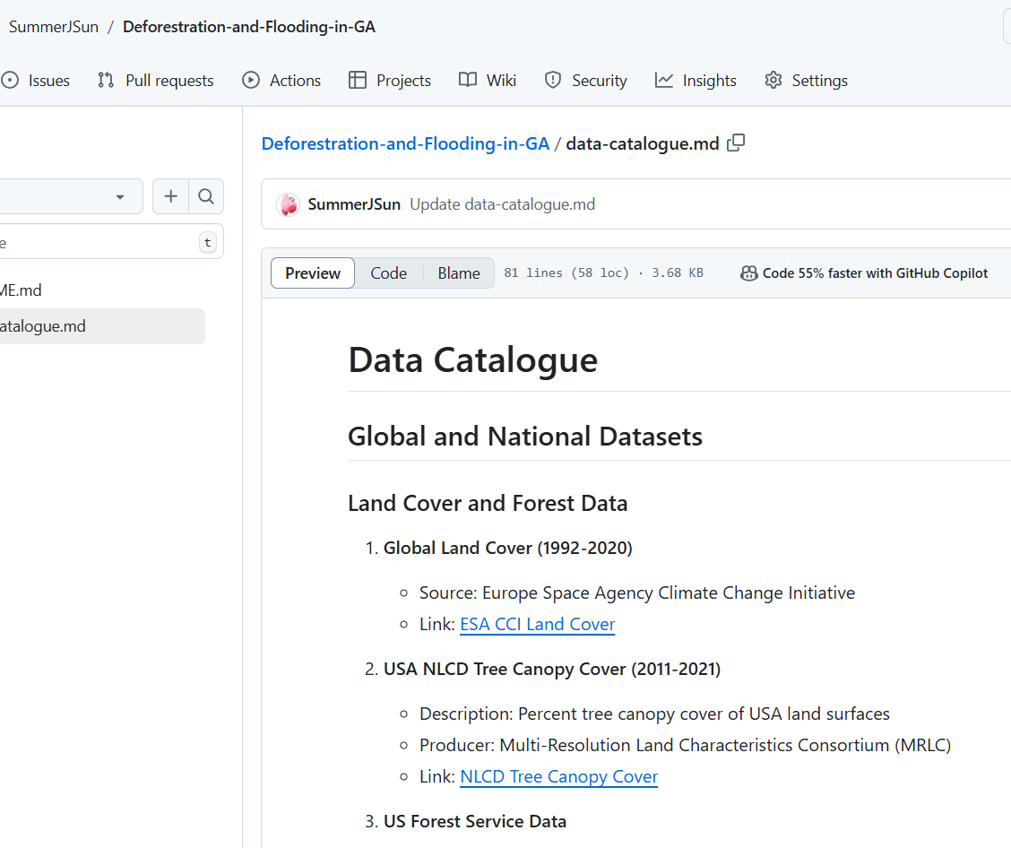
Data Sources
Main useable Data source:
FEMA Flood Hazard Area (via official website and CDC data portal)
EPA Flood Hazard Area (via CDC data portal)
NASA Real-Time Global Flood Product
USGS Annual National Land Cover Database
Data catalogue and analysis code on Github:
https://github.com/SummerJSun/Deforestration-and-Flooding-in-GA/blob/main/data-catalogue.md

Slide 6
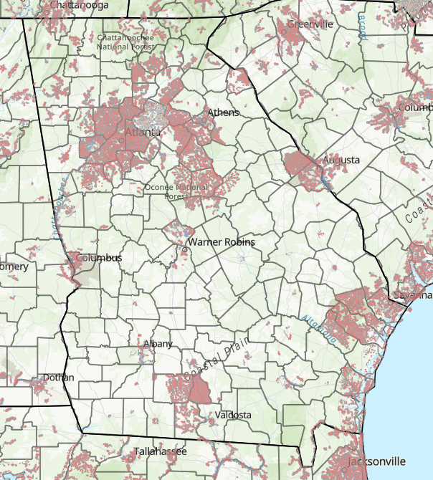
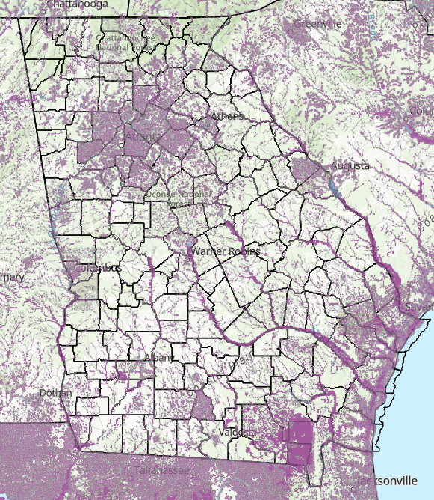
Flood Hazard Zone Distributions From FEMA (2018)
Flood Hazard Zones are concentrated near Atlanta & Southeast costal area
Area has 0.2% chance of hitting by a flood in a year
Area has 1% chance of hitting by a flood in a year
Notes:
The two map were plotted from FEMA’s flood hazard zone distributions. FEMA's flood hazard zones are geographic areas that FEMA has defined according to varying levels of flood risk. The zones, are primarily used to determine insurance requirements and building standards. The two main type of flood hazard zones are plotted side by side: the red zones on the left are areas that has 0.2% chance of hitting by a flood in a year. The purple zones on the right are areas that has 1% chance of hitting by a flood in a year. The purple areas are more likely to flood. We can tell that Flood Hazard Zones are concentrated near Atlanta & Southeast costal area.
0.2% and 1% area overlap issue
Change in region over time
How do FEMA & EPA generate flood hazard zone areas

Slide 7
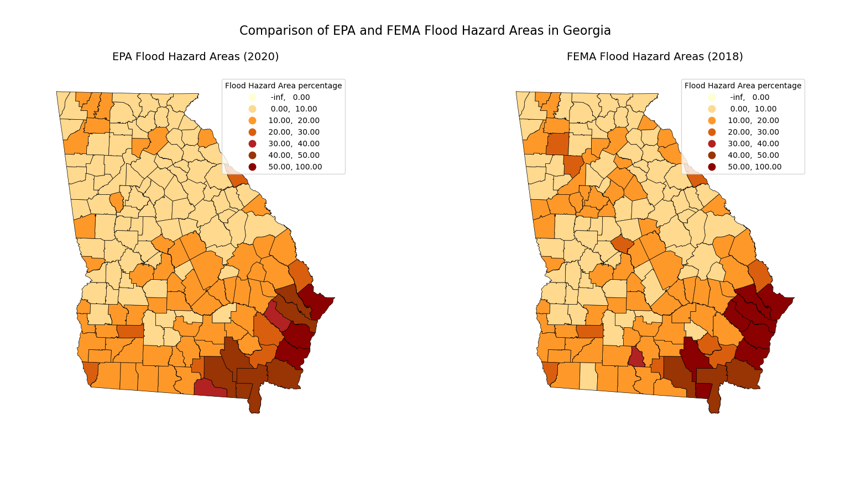
EPA & FEMA Flood area percentage Comparison
How to read: example: Chatham county, according to EPA data, above 50% area of the county has a 1% chance (or 0.2% chance) of hitting by a flood in a year
The southeastern coastal region of Georgia shows the highest flood hazard percentages.
TOP5 county for EPA: Chatham, McIntosh, Glynn, Charlton, Liberty
TOP5 county for FEMA: Long, Chatham, Liberty, Bryan, Glynn
There’s difference in classification
EPA and FEMA aggregate their data differently.
Notes:
After we get an overall sense of the flood areas look like, let’s take a look into the flood area percentage for each county. Counties with deeper color means higher percent of the land in this county are in flood hazard zones. The two maps are data from two data sources: the EPA flood hazard areas, and the FEMA flood hazard areas.
Solve the difference problem

Slide 8
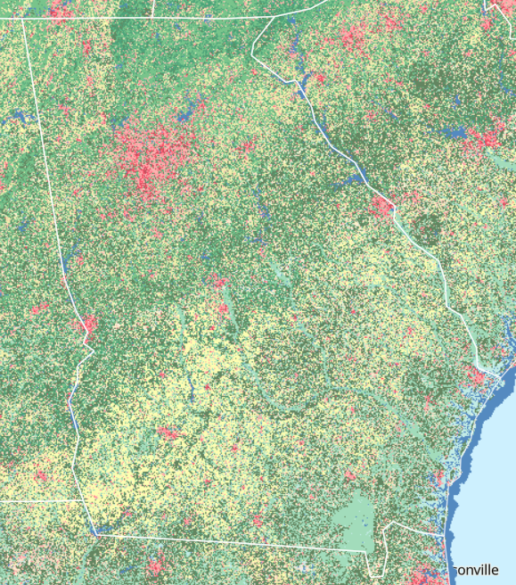
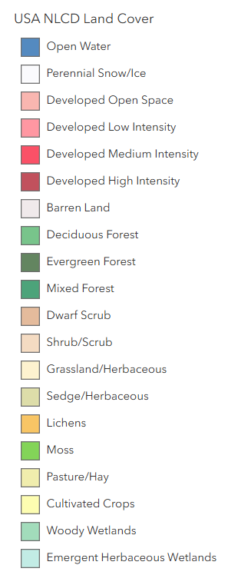
Land Cover Visualizations from National Land Cover Database
Area that are hazard area of flooding mainly overlaps with three kinds of land cover:
Developed sites (near Atlanta area)
Woody Wetlands (Southeast Costal area)
Cultivated Corps (South)
Area where majority of land were covered by forest are mostly not likely to flooding
Notes:
After we looked through the flood conditions, let’s take a look at the land cover visualizations from National Land Cover Database.
Emily: https://croplandcros.scinet.usda.gov/ crop land data

Slide 9
Side to Side Comparison
Notes:
Woody wetland --- do they flood?
Developed sites (near Atlanta area)
Woody Wetlands (Southeast Costal area)
Cultivated Corps (South)
Which data should be look into when comparision

Slide 10
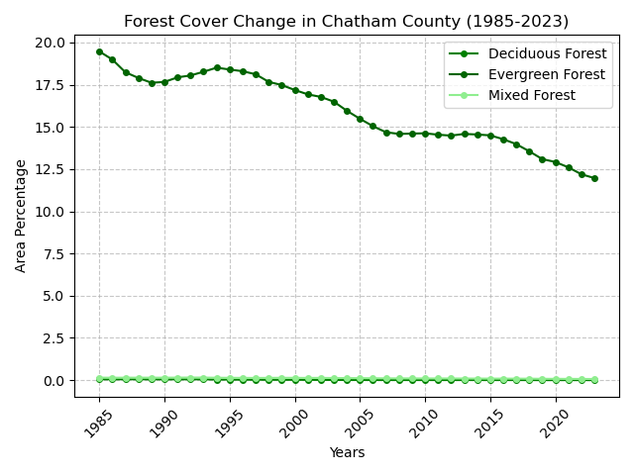
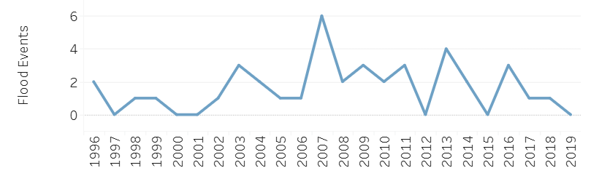
Side to Side Comparison: A closer look
Take Chatham County as an example
70% of the area of Chatham County has 1% chance of hitting by a flood in a year
Deciduous Forest in this county decreased around 8%
Flood trends: the number of flood events varies, but overall are increasing
The flood events by year is available at https://www.fema.gov/data-visualization/historical-flood-risk-and-costs

Slide 11
What next?
For my team from capstone class:
Identify more useable data source while get rid of those that are not useable
Find the change of factors over time
Solve the discrepancy problems in data, process messay data (e.g. NASA flood event)
Merge the Flood data and the Land cover data, make comparisons, identify trends
Make final visualizations: the key would always be presenting fruitful results to help the community!
Just my basic ideas. I’m always open to more creative approaches and explore more!
Notes:
Government’s reaction to extreme weathers?

Slide 12
TIMELINE (Tentative)
2 weeks: Data Preprocessing; Identify sources, and filter out those useless data
1-2 weeks: Preliminary analysis, identify trends
Spring Break
1-2 weeks: Complete analysis, make visualizations, recommendations
Everyone procrastinate. But let’s try to get things done early and don’t let this project bother you in the final weeks:)

Slide 13
Appendix
The Github Repository that contains all my analysis code and data catalogue:
https://github.com/SummerJSun/Deforestration-and-Flooding-in-GA
Other visualizations are on ArcGIS site for Science for Georgia

Slide 14
Thanks for Listening!

